Slide 1

Intro to Elixir
Putting “fun” in “functional”
Cedric Rutland Wienold (cwienold@gmail.com)
github/cedmans https://cedmans.io/
Notes:
Modern Functional Language
Most exciting new language since Ruby
Includes all the shiny, beautiful features we've always wanted in a language

Slide 2

Let’s Get Excited
WhatsApp
1 billion monthly users
Bought by Facebook for $19 billion (２兆円)
64 billion messages / day
10 erlang engineers
Notes:
Now let’s get excited!
WhatsApp is like Line or KakaoTalk, really famous in the US.
1bil users monthly
$19bil purchase (FB’s largest purchase by almost 10x)
Behind that are Oculus for $2bil, and Instagram for $1bil
64bil messages daily
concurrency out the wazoo
10 erlang engineers
100mil users per engineer
So if you’re thinking of ideas for your next project, erlang tech certainly has a lot of return on investment!

Slide 3

Ok, Erlang Rocks; What about Elixir?
Discord
VoIP Voice + Chat (like Slack, but voice-focused)
Ranked 170 Most Popular Site by Alexa Ahead of Steam, Hulu, and GitHub
130 million registered users
5 million concurrent connections
“We don’t have any regrets with our choice of infrastructure”
Notes:
So I’ve convinced you that Erlang is awesome, so why care about elixir?
Discord
It’s like Slack, but focussed on voice chat rooms
(much more data- and processing-intensive than text-based)
Ranked 170 on Alexa’s list of most popular sites, putting it ahead of GitHub. GITHUB!
130 million registered users, and 5 million concurrent connections at any given time
No regrets with choosing Elixir from the start

Slide 4
Erlang? BEAM? Elixir?
Erlang (compare to Java)
Developed in 1986 by Ericsson
Compiles into BEAM bytecode
BEAM (compare to JVM)
VM upon which erlang code runs
Elixir (compare to Scala/Clojure)
Ruby-flavored language that compiles into BEAM bytecode
Elixir Source Code → Elixir AST → Erlang AST → Core Erlang → BEAM Byte-code
Notes:
Let’s define a few terms (and I’ll compare them with known languages)
Erlang: Like Java, long history with a strong industry presence
Built to power telephony systems
Created by Ericsson in 1986 because no existing language handled concurrency and crash resilience without a lot of manual work by the programmer
BEAM: “Bogdan’s Erlang Abstract Machine”
Like the JVM, this is the OS upon which Erlang byte-code runs
Handles all process scheduling and multithreading
Elixir: Like Scala/Clojure, improves upon the original language
Ruby syntax is more approachable and easier/more pleasing to program in
BEAM bytecode means that it’s effectively the same language to the BEAM

Slide 5
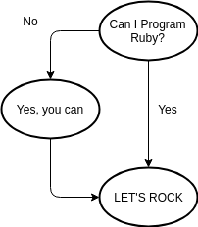
Am I Even Capable?

Slide 6
Fact Sheet
Released on 2011
Gives the joy of Ruby
Solves massive concurrency with Erlang
Features
Fault Tolerance
Concurrency
Interoperability with Erlang
High Availability (99.9999999% Uptime)
Notes:
2011
José Valim: Rails Core Team Member, “Ruby Heros” award holder
Saw problems with how Ruby handled concurrency and multithreading
Read “Seven Languages in Seven Weeks”, learned about Erlang (available on Safari Books, btw)
Others built legendary systems using Erlang, but it’s not a very friendly language
Created a Ruby flavor to solve that friendliness problem
Features
Fault Tolerance: Crashes will not bring down your system
Concurrency at its core: language is designed to make concurrency easy to imagine and build
Anything that’s obviously concurrent in theory should be simple to make concurrent in practice
Erlang interop if you have a library that’s not been ported to Elixir: POWERFUL THING
Many core erlang libraries are actually still the go-to libraries in Elixir, as Elixir discourages merely wrapping Erlang libraries
crypto
digraph for graphs
ets for global data storage
math
9-sigma uptime on the BEAM
99.9% is considered “good”: 8.76 hours in a year: network providers, SaaS, state governments
99.9999999% boasted by Ericsson: 31.6 milliseconds
That’s NOT every process, but the whole system: crash-handling keeps the system running if one process fails

Slide 7
Why Elixir?
Approachable, Productive, Modern Tooling
`mix` command for general project scripts
Package management through Hex
`iex` REPL
Does not require constant diligence
No constant need to predict every possible failure.
Supervisors for automated process restart
Notes:
Tooling
“Mix” is like npm in node (or gulp, if that’s how you swing)
$ mix help
Hex is akin to packagist for Node
$ mix hex
$ mix hex.search csv
“iex” is a powerful REPL that’s just amazing (demo)
$ iex
Iex> do stuff
No constant diligence
erlang’s library system is designed to crash subprocesses gracefully, so that a crash will not bring down the system
Supervisors can be set up to restart a process with its last known good state
Ergo, no need to program in preparation for failure, which allows you to….

Slide 8
Code the Happy Path
Notes:
Instead of pre-emptively watching for every failure, code for what you want to do
Watch for failures you expect to handle (path not found, invalid credentials)
Let the process crash for everything else. It’s OK!

Slide 9
Types
$ iex
Erlang/OTP 20 [erts-9.3] [source] [64-bit] [smp:2:2] [ds:2:2:10] [async-threads:10] [hipe] [kernel-poll:false] Interactive Elixir (1.6.3) - press Ctrl+C to exit (type h() ENTER for help)
iex(1)> 1 # Integer 1
iex(2)> 0x2f # Integer 47
iex(3)> 1.0 # Float 1.0
iex(4)> :atom # Atom :atom
iex(5)> "Hello" # String "Hello"
iex(6)> <<72, 101, 108, 108, 111>>> # Binary "Hello"
iex(7)> [1, 2, 3] # List [1, 2, 3]
iex(8)> [104, 101, 108, 108, 111] # Another list 'hello'
iex(9)> {:ok, 1} # Tuple {:ok, 1}
iex(10)> %{a: 1} # Map %{a: 1}
Notes:
This is iex: Interactive Elixir

Slide 10
Maps
Key-Value Store
iex(1)> person = %{ ...(1)> name: "Tarō", ...(1)> yamaguchi: true ...(1)> } %{name: "Tarō", yamaguchi: true}
iex(2)> %{person | yamaguchi: false} %{name: "Tarō", yamaguchi: false}
iex(3)> person %{name: "Tarō", yamaguchi: true}
Notes:
Did you see that? Multi-line commands.

Slide 11
Pattern Matching
Validate the form of data
“Overloading” functions
Pick useful bits of info out of data structures easily

Slide 12
Pattern Matching: Examples
[1, 2, 3] = [1, 2, 3] # Matches
[1, b, 3] = [1, 2, 3] # Matches, binds 'b' to 2
[first | rest] = [1,2,3,4] # Matches, first = 1, rest = [2, 3, 4]
[1, 2] = [1, 2, 3] # ERROR: Does not match
Enum.fetch([1, 2, 3], 1) # => {:ok, 2}
{:ok, number} = Enum.fetch([1, 2, 3], 1) # => number = 2
{:ok, ^number} = Enum.fetch([1, 2, 3], 0) # => Error: 1 != 2
user_info = %{ id: 1, email: "fake@example.com" }
%{email: user_email} = user_info # => user_email = "fake@example.com"
Notes:
Demo Code:
defmodule Analytics do
def export(%{name: name, address: address}) do
IO.puts("#{name} lives at #{address}")
end
end
defmodule Accounts.API do
def get_user_info() do
%{
user_info: %{
name: "Tarō Yamaguchi",
age: 29,
phone_numbers: [
%{
type: "home",
number: "555-5555-5555"
},
%{
type: "work",
number: "666-6666-6666"
}
],
addresses: %{
main: "123 Fake Street, Springfield, USA",
secondary: "Secret Location, Japan"
}
}
}
end
end
with %{
user_info: %{
name: name,
addresses: %{
main: main_address
}
}
} <- Accounts.API.get_user_info() \
do
%{
name: name,
address: main_address
}
else
_ -> raise :invalid_user_info_format
end \
|> Analytics.export()

Slide 13
Modules
Container to group like-minded functions
defmodule Adder do def add(a, b) do
a + b
end
end
Adder.add(1, 2) => 3
Contrasts with Classes in that there is no state

Slide 14
Structs
Maps with compile-time checks
Defined in Modules
defmodule Adder do
defstruct [:first, :second]
def add(a, b) do
a + b
end
def add(%Adder{first: a, second: b}) do
add(a, b)
end
end
Adder.add(%Adder{first: 1, second: 2})
%ModuleName{
property: value,
property: value,
…
}
Notes:
While this might look like an instance of the module, it isn’t
It is only a map with meta information about the module it came from, for use in pattern matching
Provides compile-time checks

Slide 15
Piping
Removes need for intermediary values
Encourages consistent function definitions
Clarifies the step-by-step transformation of data
Notes:
Removes need for intermediary values
Encourages consistent argument order in function definitions (most important data first)
Clarifies the step-by-step transformation of data
The operation looks like an atomic operation, which is easier to conceptualize

Slide 16
Piping: Before
var result =
thirdOp(
secondOp(
firstOp("ホゲ")
)
) ;
var firstOpResult = firstOp("ホゲ");
var secondOpResult = secondOp(firstOpResult);
var thirdOpResult = thirdOp(barResult);
Notes:
Let’s say you have three consecutive operations to do to some input data.
In your earliest JavaScript days, you may have created this monster
It’s somewhat readable, although it reads backwards
So to improve it, you might use intermediate variables
That’s better, but it feels kludgy to have to come up with variable names and manage variables for what should be a single stream of operations

Slide 17
Piping: After
result = "ホゲ"
|> firstOp()
|> secondOp()
|> thirdOp()
Notes:
First argument in a pipe is the previous value or result of the previous function invocation
Can add more arguments after this
Live Demo: Getting Kanji from a string
defmodule KanjiParser do
@kanji_utf8_range 0x4e00..0x9faf
defp in_kanji_range?(charcode) do
charcode in @kanji_utf8_range
end
defp charcode_to_character(charcode) do
<<charcode :: utf8>>
end
def from_string(string) do
string
|> String.to_charlist()
|> Enum.fitler(in_kanji_range?)
|> Enum.map(charcode_to_character)
end
end
KanjiParser.from_string("今日の勉強会は準備できたの？")

Slide 18
Piping: More Interesting Example
%{ username: "taro@yamaguchi.co.jp", password: "secure-password123" }
|> Authorization.get_access_token()
|> Accounts.get_address(:main)
|> Analytics.add_address_to_report()

Slide 19
Pattern Matching & Guards in Functions
iex(1)> defmodule Adder do ...(1)> def add(a, b) do ...(1)> a + b ...(1)> end ...(1)> end
iex(2)> Adder.add("a", "b")
** (ArithmeticError) bad argument in arithmetic expression iex:3: Adder.add/2
iex(1)> defmodule SafeAdder do ...(1)> def add(a, b) when is_number(a) and is_number(b) do ...(1)> a + b ...(1)> end ...(1)> end iex(2)> SafeAdder.add("a", "b") ** (FunctionClauseError) no function clause matching in SafeAdder.add/2 The following arguments were given to SafeAdder.add/2: # 1 "a" # 2 "b" iex:2: SafeAdder.add/2
Notes:
Guards: https://hexdocs.pm/elixir/guards.html#list-of-allowed-expressions
Let’s look at the Adder again

Slide 20
Effortless Clustering
This is too hard to put on a slide. I hope you were watching!
Notes:
# food.ex
defmodule Food do
def eat() do
“Woof!”
end
end
$ iex --sname dog
iex(dog@machine)> c(“./food.ex”, “.”)
iex(dog@machine)> Food.eat()
$ iex --sname cat
iex(cat@machine)> Node.list()
iex> Node.connect(:”dog@machine”)
iex(cat@machine)> Node.list()
iex(dog@machine)> Node.list()
iex(cat@machine)> Food.eat()
$ iex --sname mouse
iex(mouse@machine)> Node.connect(:”cat@machine”)
iex(mouse@machine)> Node.list()
iex(dog@machine)> Node.list()
# food.ex
def eat() do
“Munch!”
end
iex(dog@machine)> r(Food)
iex(dog@machine)> Food.eat() => “Munch!”
iex(cat@machine)> Food.eat() => “Woof!”
iex(cat@machine)> r(Food)
iex(cat@machine)> Food.eat() => “Munch!”
iex(mouse@machine)> Food.eat() => “Woof!”
# food.ex
def eat() do
“Yum!”
end
iex(dog@machine)> c(“food.ex”, “.”)
iex(dog@machine)> Food.eat() => “Yum!”
iex(dog@machine)> nl(Food)
iex(cat@machine)> Food.eat() => “Yum!”
iex(mouse@machine)> Food.eat() => “Yum!”

Slide 21
Things I Couldn’t Cover (yet)
Typespecs & Static Analysis
Endless Syntactic Sugar
“with” <- pattern matching + piping + advanced control flow
List Comprehensions (one-line list generators and filters)
Processes and Message Passing (Concurrency)
And how you can start “thinking concurrently”
Preemptive Scheduling
Versus Cooperative Scheduling (Go, JS)
OTP (The Secret Sauce of Generic Concurrent Programming)
… And more very cool things
Notes:
Typespecs & Static Analysis
Help guarantee that any code that passes static analysis does not crash
Endless Syntactic Sugar
“with” <- pattern matching + piping + advanced control flow
List Comprehensions (one-line list generators and filters)
Processes and Message Passing (Concurrency)
And how you can start “thinking concurrently”
Preemptive Scheduling
Versus Cooperative Scheduling (Go, JS)
OTP (The Secret Sauce of Generic Concurrent Programming)
This gets us our 9-sigma uptime
… And more very cool things

Slide 22
Conclusion
Friendly Functional Language
Accomplish more with less code
Massive Concurrency & Fault Tolerance Automatically
Modern Tooling to Get You Started Quickly
Notes:
Friendly Functional Language
Accomplish more with less code
Pattern matching: No need to check input types, not necessary to deal with every possible failure case
Language construct to make complex code clear and easy to create
Massive Concurrency & Fault Tolerance Automatically
Two things I couldn’t actually go over today
Modern Tooling to Get You Started Quickly

Slide 23
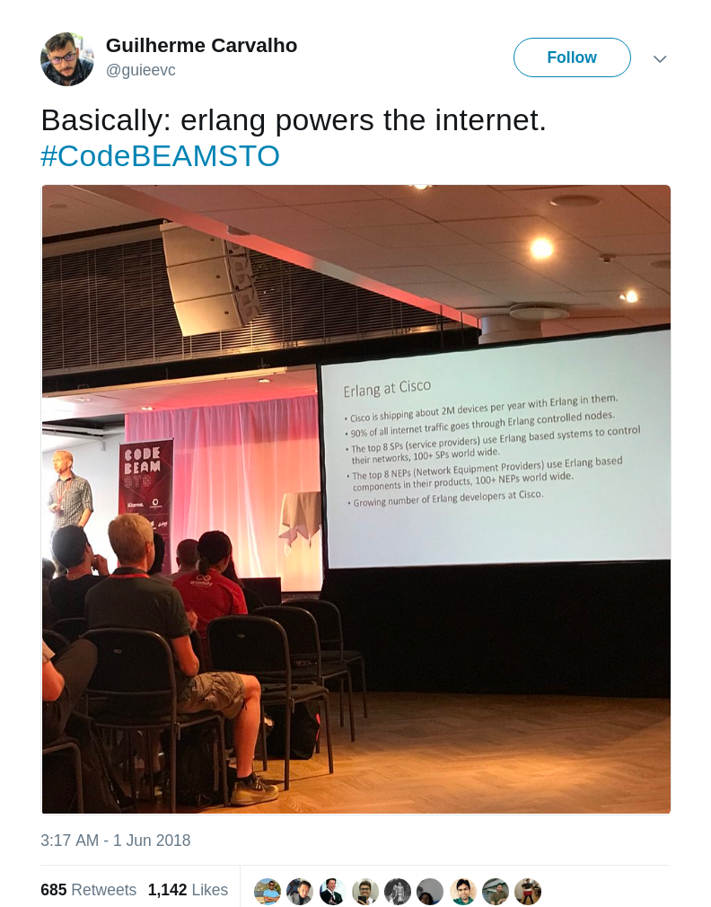
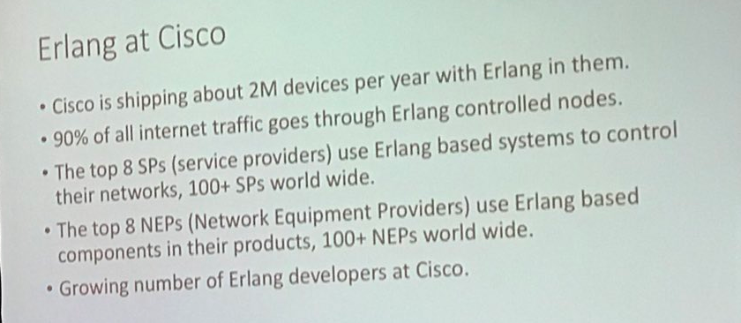
BEAM Powers the Internet
https://twitter.com/guieevc/status/1002494428748140544
Notes:
Cisco @ Code Beam conf in Stockholm
A couple of interesting numbers here:
2mil erlang-powered devices/year
Top 8 service providers use erlang-based systems
Growing demand for erlang engineers
90% of all internet traffic goes through Erlang-controlled nodes

Slide 24
Fin.
Q/A

